Slide 1
Professional Help for PowerShell Modules
June Blender
Technology Evangelist
SAPIEN Technologies, Inc.
Windows PowerShell MVP
juneb@sapien.com
@juneb_get_help

Slide 2
Tested Versions
The information and code used in this presentation were tested with the following system attributes.
Windows 7 Pro RTM, Windows Server 2012 R2 Ultimate, Microsoft Windows 10 Pro 10.0.10586 (x64), Windows Server 2012 R2 (x64), Microsoft Window 10 Home Insider Preview 10.0.14279
Windows PowerShell 3.0, 4.0, 5.0.10586.122, 5.0.14279.1000
Contact: June Blender, @juneb_get_help, juneb@sapien.com

Slide 3
Slides and code for all help talks: PowerShell Help Deep Dive (GitHub) https://github.com/juneb/PowerShellHelpDeepDive

Slide 4
Agenda
Why write help -- for modules?
Rules & Syntax
Comment-based help v. XML help
Improve the content
Write great cmdlet help - Use checklists
Writing great About Help
Re-purposing Github wiki

Slide 5
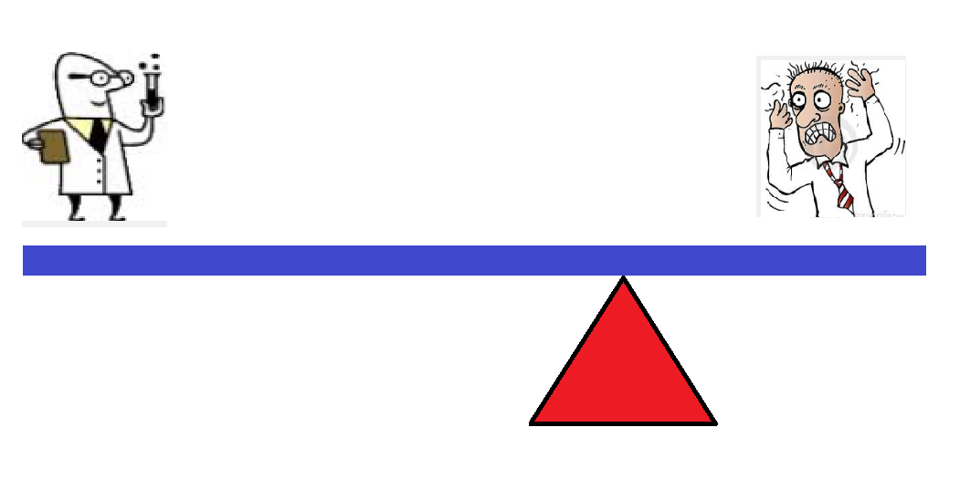
I'm too busy to write help... ... shifting the burden
Inefficient
Notes:
Direct positive correlation

Slide 6
Undocumented tool -EQ Unautomated process
Inefficient

Slide 7
Why write help for a module?
Likely to share it
Like to keep it (and need to maintain it)
More complex than a script
More valuable

Slide 8
How is help different for a module
Examples are intertwined
About topic (at least one; typically more)
Benefit from "Get-Help -Online"

Slide 9
Don't write help for your own module
Find a writer
Get a buddy
Immersed in the implementation
Need a beginner perspective focused on the user experience

Slide 10
Benefits to the Author of Writing Help
It makes you a better blogger and instructor
Writing help as a code spec
Examples -EQ Tests
Notes:
Practice in explaining concepts and writing instructions; People who write good help are good instructors; People who are good instructors write good help

Slide 11
"Help-Driven Development" Help as a code specification
Description: Describe the UI.
Examples:
Which parameters you need
Recognizable parameter names
Parameter attributes
Parameter combinations -> parameter sets
Expected outcomes for testing
Inputs: Coordinate types with other cmdlets
Outputs: Define return values
Advanced Help for Advanced Functions #PSBlogWeek

Slide 12
"Help-Driven Development" Help Examples as a Pester test spec
Help examples are user contract
Supports behavior-driven development
Supports "white box" testing
Test input possibilities
Test piping between cmdlets
https://github.com/juneb/PesterTDD
Notes:
Force you to confront issues that you'd rather forget; but that users will encounter

Slide 13
Mechanics: A few hints about help syntax...

Slide 14
Comment-based help v. XML help
 | XML Help | Comment-Based Help
CIM Commands | x
Cmdlets | x
Functions | x | x
Providers | x
Scripts |  | x
Workflows | x | x (4.0+)

Slide 15
Comment-Based Help Costs/Benefits
Benefits
Easy
Help always matches code
Costs
Not supported for cmdlets, providers, CIM commands
No updatable help
No multi-language support
FRAGILE !

Slide 16
What can go wrong with comment-based help?
One keyword typo, all ignored
One misplaced value, all ignored
More than one empty line between help and function
Troubleshooting Comment-Based Help
Notes:
What if you hedge your bets and use both.
In a script module with correctly-formatted .EXTERNALHELP, an error in comment-based help -> autogenerated help

Slide 17
XML Help Costs / Benefits
Benefits
All command types (cmdlets/functions/workflows/CIM commands)
Updatable Help
Multiple spoken languages
Robust; error-safe
Separates help from code (Github)
Costs
PSMAML XML or Markdown file -> XML
Help might not match code

Slide 18
What can go wrong with XML help?
Naming XML help files
Missing #.ExternalHelp keyword in functions
(3.0 file names)
Comment-based help takes precedence over XML help
# .ExternalHelp keyword takes precedence over CBH
Command not found (Get-Help uses Get-Command)
Invalid schema (rare; pretty forgiving)
Writing XML Help for Advanced Functions
Notes:
What if you hedge your bets and use both.
In a script module with correctly-formatted .EXTERNALHELP, an error in comment-based help -> autogenerated help

Slide 19
Naming XML Help Files Cmdlets, CIM commands, Workflows
PowerShell 3.0
<CmdletDefinitionFile>-help.xml
MSFT_NetQosPolicy.cdxml-help.xml
Microsoft.PowerShell.Archive.dll-help.xml
PowerShell 4.0 (5.0 script modules)
<ModuleName>-help.xml
Microsoft.PowerShell.ODataUtils-help.xml
Writing XML Help for Advanced Functions

Slide 20
Naming XML Help Files Functions
PowerShell 3.0 No filename requirements. Requires # .ExternalHelp comment keyword
function Get-Widget {
# .ExternalHelp MyModule.psm1-help.xml
}
PowerShell 4.0 (Works for script modules beginning in 5.0)
<ModuleName>-help.xml
Does not require #.ExternalHelp comment
Writing XML Help for Advanced Functions

Slide 21
.ExternalHelp keyword
Associates a function with an XML help file
# .ExternalHelp <filename>-help.xml
function MyFunction {}
3.0: Required for functions
4.0: Required for script modules Optional in manifest modules (value ignored)
5.0: Required only for 3.0 XML help file names
<ModuleName>.psm1-help.xml
Writing XML Help for Advanced Functions

Slide 22
Where do I put help files? XML, About
In language-specific subdirectory of a module directory, e.g. en-US
In the root of the module directory
In the subdirectory of the module directory (should work...)
Writing XML Help for Advanced Functions

Slide 23
It's all about the content!
PowerShell Help Deep Dive (GitHub)

Slide 24
Code comments v. help
"I have code comments. Isn't that enough?"
"I'll just put my code comments in comment-based help."
What's different? They're opposites!
Audience
Perspective
Subject

Slide 25
Easy (help) writing rules
Use clear, simple language
Get, not "retrieve"
Use, not "utilize"
Change, not "modify"
Be careful with "remove" -- is this permanent? Delete?
Use active voice:
Passive: The objects can be exported ...
Active: You can export the objects ... To export the objects, <do this>.
Notes:
If the credential changes, an error occurs. If a user name is entered, a password prompt is displayed.

Slide 26
Easy (help) writing rules
Give instructions in the order that the user needs them.
Click Run in the Things section of the Home tab.
Click the Home tab and, in the Things section, click Run.

Slide 27
Easy (help) writing rules
Task first, then instructions: (Start with "To")
Use the Format parameter to format the date.
To format the date, use the Format parameter.
Using the Credential parameter will help you to avoid Access Denied errors.
To avoid Access Denied errors, use the Credential parameter.

Slide 28
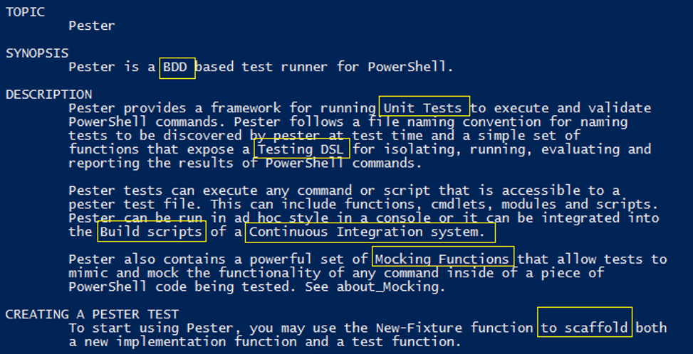
Define technical terms

Slide 29
Reuse content
You don't have to be original. Reusing is efficient.
Reuse parameter descriptions!
Be sure to cite and credit the original author with a link.

Slide 30
Write, use, and share checklists
Checklists for Authoring PowerShell Help on GitHub
http://github.com/juneb/PowerShellHelpDeepDive

Slide 31
Synopsis Checklist "Elevator speech" Will this cmdlet solve my problem?
Identify the technology (What kind of disk?)
Describe the action and outcome
Generic v. specific (Removes all events from the session.)
Checklists for Authoring PowerShell Help

Slide 32
Use Synopsis Checklist: Invoke-Pester (3.4.0)
Identify the technology (What kind of disk?) Testing PowerShell code
Be specific about the action and outcome. Runs *.Tests.ps1 files. Recursive.
If it's generic, say so.
All by default; parameters filter the tests
Result:
Runs all or selected Pester tests (*.Tests.ps1) in a directory and its subdirectories.

Slide 33
About Help Without it, your module is a confusing collection of unrelated commands.

Slide 34
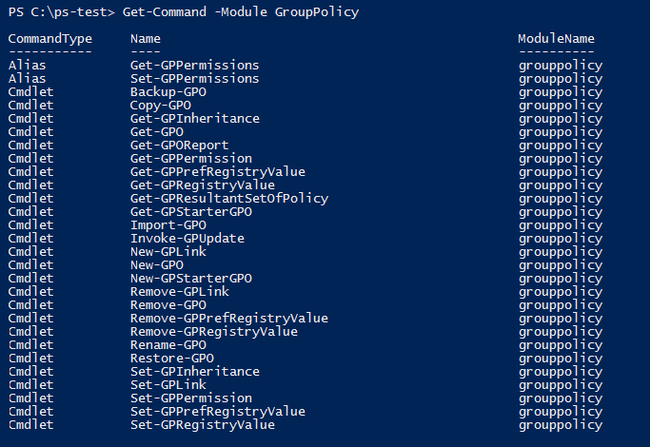
Where do I start?

Slide 35
About Help file about_<Topic>.help.txt
Module directory
In a language-specific subdirectory

Slide 36
about_Topic Template : 1000-1500 words
TOPIC Line 1, column 1 about_<Name> Line 2, column 5
Line 3 (blank)
SHORT DESCRIPTION Line 4, column 1
<Description> Line 5, column 5
LONG DESCRIPTION
<SUBTOPICS>
EXAMPLES
NOTE:
TROUBLESHOOTING NOTE: #Known bugs
SEE ALSO #Add URL of your Github wiki
KEYWORDS
* UTF-8 encoding

Slide 37

Maybe I'll fold laundry instead.

Slide 38
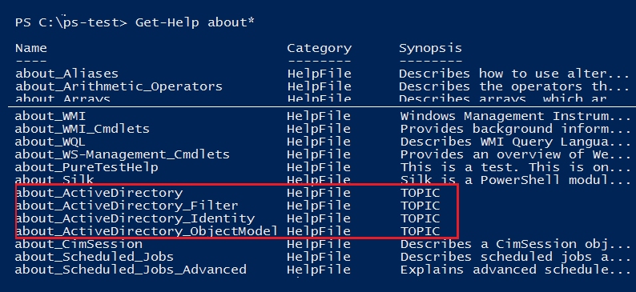

Slide 39
About Help Checklist
"It tells the story of your module." -- Chrissy LeMaire
What problem does the module solve?
How do I use the cmdlets together to solve it?
Meta-cmdlet help
In what order do I use the commands?
Is one a prerequisite?
Is one designed to pipe to another?
Examples+++

Slide 40
about_Pester

Slide 41
Short Description
1-2 paragraphs that describe the concept.
"Will this module solve my problem?"
In which domain or technology does it work?
System requirements
If the topic is long, list the subtitles in this section, like a table of contents.

Slide 42
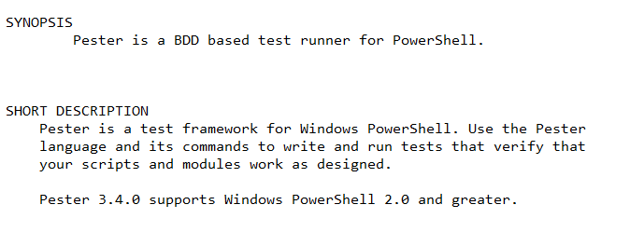
Short Description

Slide 43
Long Description Start with an outline
Brainstorm your subtopics.
Arrange subtopics in an order useful to the reader.
Simple to complex
Basic to advanced
Required order: Get/Set
Write a sentence or paragraph for every subtopic.
Reorder subtopics. Best order for the reader.
Have a friend read it.

Slide 44
Long description: Typical ordered outline
Purpose / Solution / Task
Basic example
Cmdlet/Function list
How-to sections (New/Get/Set/Save)
Examples (try it)
Background info
Notes:
PowerForensics: Invoke-ForensicDD, Get-ForensicBootSector (master boot record v. guid partition table)

Slide 45
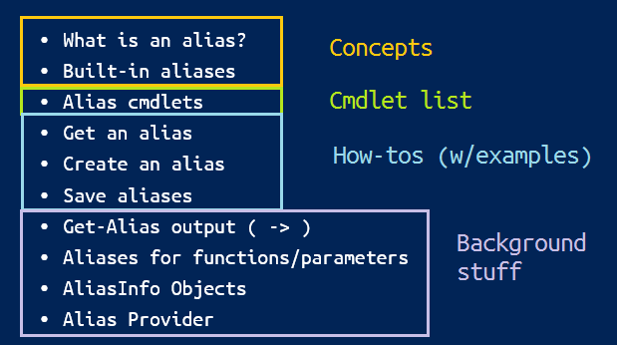
about_Aliases

Slide 46
about_Pester : Long description outline
Problem statement: Unit/integration testing
Language basics, DSL (describe, it, should be)
How-to: Create, Write, Run
How to save; default output is Write-Host
Example. Try it.
Real-world examples (from original file)

Slide 47
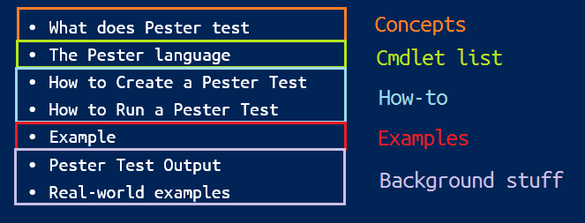
about_Pester : Long description final
What does Pester test (concepts)
The Pester language (basics + example)
How to Create a Pester Test
How to Run a Pester Test
Example
Pester Test Output (Write-Host v. custom object)
Real-world examples (Pester's own tests)

Slide 48
Can I use my GitHub wiki?
YES!!
It's online help!

Slide 49
Supporting "Get-Help -Online"
PS C:\>Get-Help Get-Widget -Online
Not for About help
Two ways to specify an online help URI for
a command:
-- First related link in help topic (precedence)
-- HelpUri attribute
Supporting Online Help (MSDN)

Slide 50
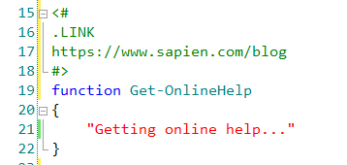
Supporting Online Help
First related link in help topic
-- Value must begin with 'http' or 'https'
Supporting Online Help (MSDN)

Slide 51
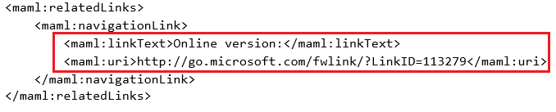
Supporting Online Help
First related link in help topic
-- Value must begin with 'http' or 'https'
Supporting Online Help (MSDN)

Slide 52
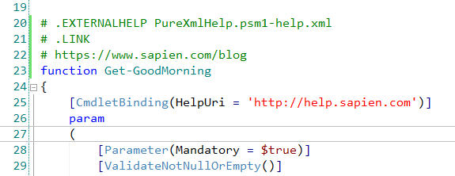
.ExternalHelp takes precedence over other comment-based help keywords

Slide 53
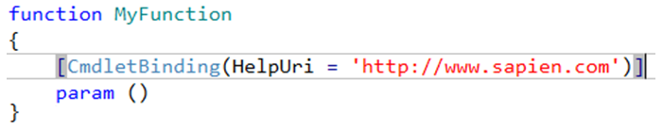
Supporting Online Help
Function: HelpUri attribute of CmdletBinding
C# Cmdlets: HelpUri attribute of Cmdlet class
CIM commands: HelpUri attribute of CmdletMetadata element
Supporting Online Help (MSDN)

Slide 54
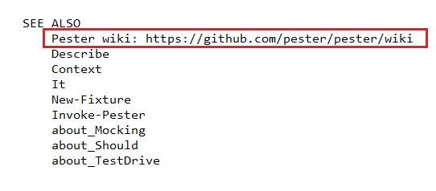
Online Help : About_help is not supported SEE ALSO
Pester Wiki (it's excellent!)
Supporting Online Help (MSDN)

Slide 55
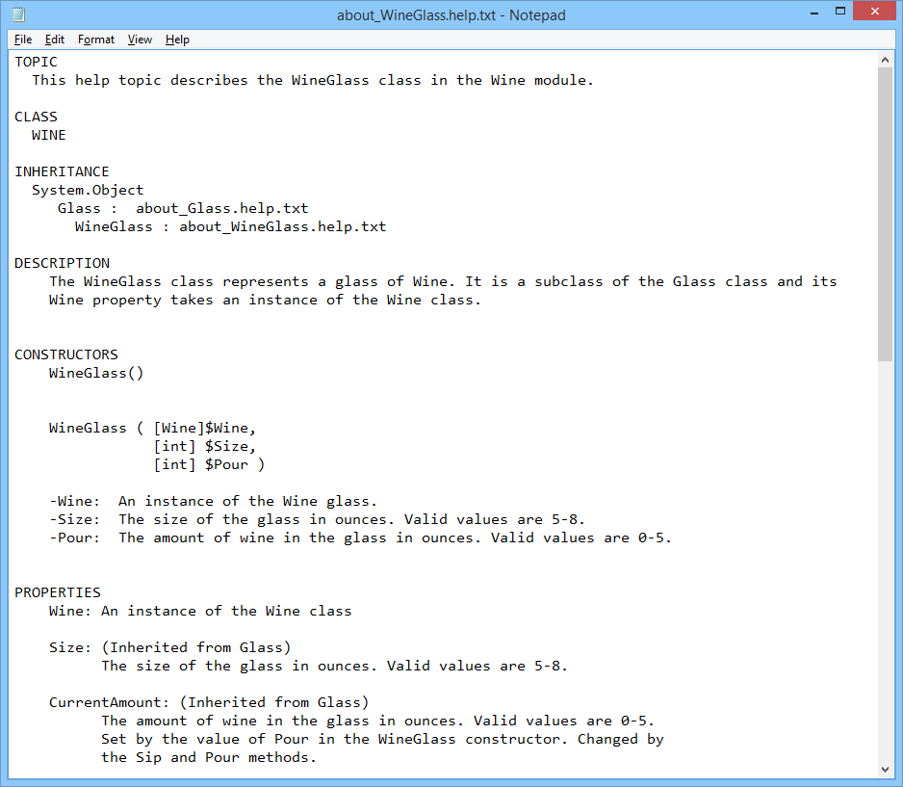
Help for DSC, Classes : About topics
about_WineGlass.help.txt

Slide 56
References
Troubleshooting Comment-Based Help Writing XML Help for Advanced Functions
Naming Help Files (PS 3.0 only; not updated for 4.0+)
Checklists for Authoring PowerShell Help
How to Write Great Help Examples
Supporting Online Help (MSDN)
Slides and code for all help talks: PowerShell Help Deep Dive (GitHub) Use help as a code spec: Advanced Help for Advanced Functions
Use help examples as a test spec: https://github.com/juneb/PesterTDD

Slide 57
Professional Help for PowerShell Modules
June Blender
Technology Evangelist
SAPIEN Technologies, Inc.
Windows PowerShell MVP
juneb@sapien.com
@juneb_get_help

